Slide 1

Data Science Intern Team "Cyber Algo"
Introduction
Feature Selection
Data Extraction
Machine Learning
Conclusion
Steven Serisky
Jonathan Osborne
Luis Fernandez Jr.
Vamsi Krishna Vandana
Dane Smith
June 29, 2018

Slide 2

Introduction | Objective
Create a machine learning algorithm to identify anomalous or adversary actions with cyber (configuration and packet data)
June 29, 2018

Slide 3
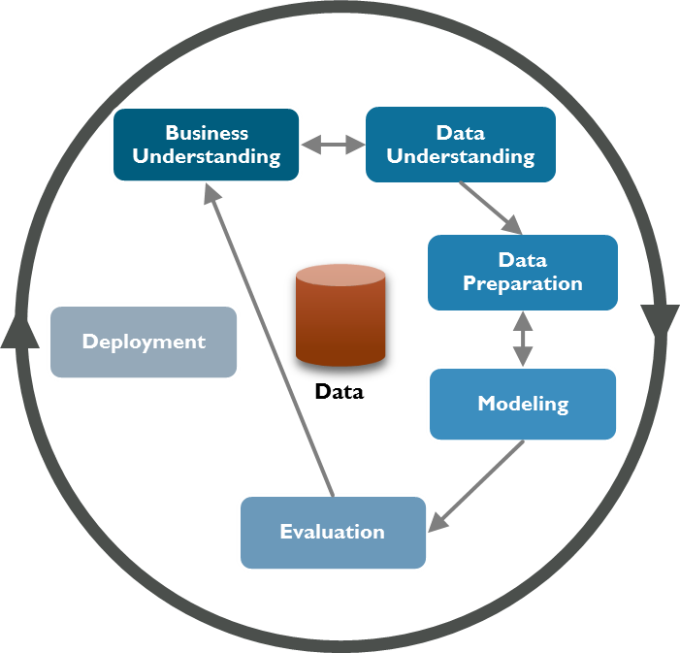
Introduction | CRISP - DM Model
June 29, 2018

Slide 4
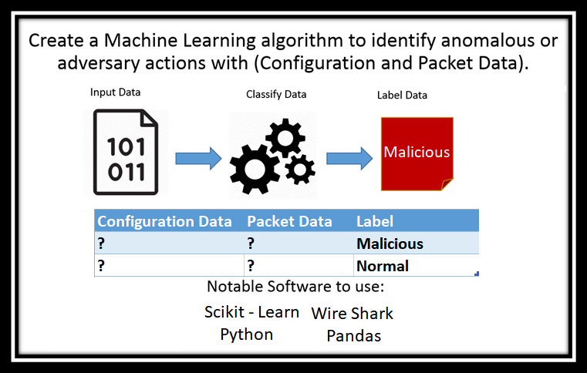
Feature Selection | Visualization & Software
June 29, 2018

Slide 5
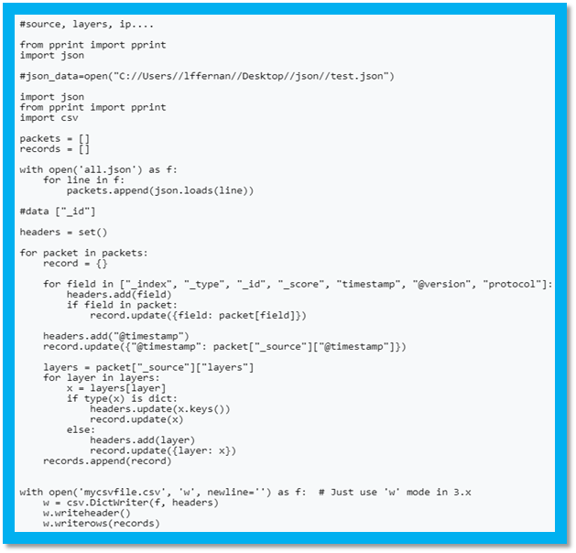
Feature Selection | Data Extract and Understanding
IP Source
IP Destination
Source Port
Destination Port
TCP Flag NS
TCP Flag CWR
TCP Flag ECN
TCP Flag URG
TCP Flag ACK
TCP Flag PUSH
TCP Flag RESET
TCP Flag SYN
TCP Flag FIN
Created Python Script to read all JSON
Identified 740 Unique Identifiers from Safe house Data
Selected 13 Features out of the 740
June 29, 2018

Slide 6
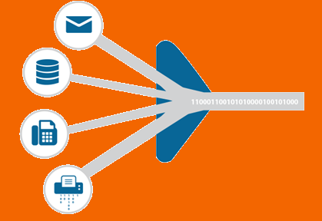
Data Extraction | Preparation
The Safe House Data is large and unclear
Discovery of miners related to Crypto-Currency
Refocus and Narrowed the scope to a new Data
"Normal" and "Malicious" Dataset discovered
New extraction needed for training
June 29, 2018

Slide 7


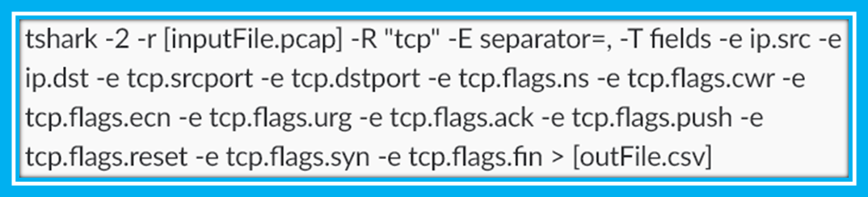
Data Extraction| WireShark & TShark
Network Packet Analyzer: Powerful, popular, and open source
Allows for deep analysis on network packets
Using TShark we extracted specific fields to .csv via commands
June 29, 2018

Slide 8
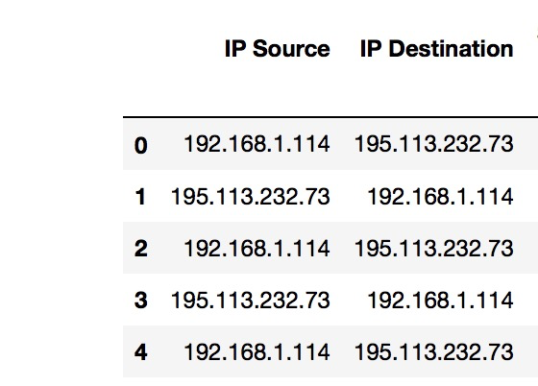
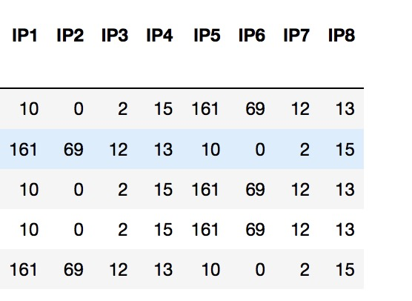
Machine Learning | Data Preprocessing
Converted the IP address into 4 different columns
June 29, 2018

Slide 9
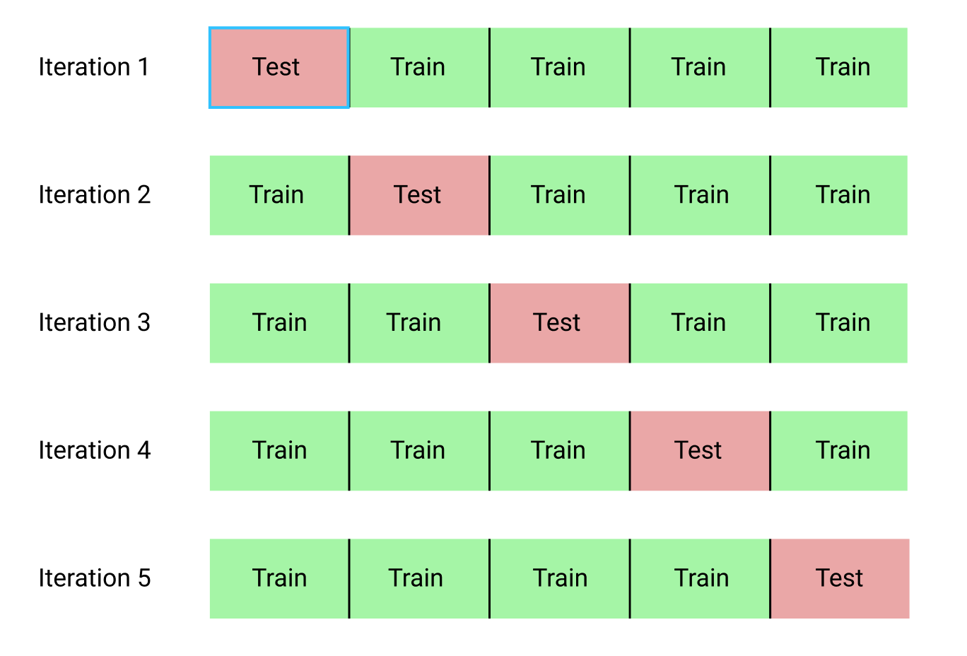
Helps maintaining a balance between bias and variance
Machine Learning | Modeling
K fold cross validation
Classification algorithms used
Logistic Regression
Random Forest Classifier

Slide 10

What We Learned | Data is Key
Relevant and sorted data is a must for training any algorithm
The machine learning model is only as smart as you teach it to be
Machine learning models work best when provided with a specific problem
June 29, 2018

Slide 11


What We Wish We could Have Done
Analyze packet payloads to better spot individually malicious packets
Analyze packet flows to identify common attacks
Check http requests, and TLS handshakes

Slide 12


